Slide 1
Union Township Comprehensive Plan

Slide 2
agenda
Present information shown at the open house in a presentation format to ensure everyone has the same level of information plus additional information.
We will also provide feedback on what we heard from the open house.
Highlight next steps.

Slide 3
What is a comprehensive plan?
A comprehensive plan
A blueprint
Guides the development and growth of a community. The ultimate goal is to gather input from residents, businesses and public officials to form a vision for the community.
Used by public officials when making decisions regarding growth.
A tool
For residents to help shape their neighborhood and a way for the community to unite around shared values.
Goals and action steps
Are identified to implement the established vision.
What does it address?
Addresses all aspects of the community
Such as land use, housing, infrastructure, economics, and recreation/open space. A Comprehensive Plan should answer questions to community needs and desires.
Notes:
A Comp Plan should answer these questions and more: What kind of aesthetic does a community want? What kind of development should occur in the community? Where, and what should it look like? How should a community balance land uses-for example, residential vs. commercial? Does the community need updated roads, multi-use paths, or bike paths? Does a community need new or updated facilities or recreational spaces? What kind of infrastructure is needed?
It is a living document that is updated regularly and adapts to changing realities over time. Change is a constant and requires communities to continually adapt their plans and strategies while ensuring any long-term changes are in line with the overall values that have been established. It needs to be updated with a deep dive every 15 years. This is where we are now in order to keep up with the changing and growing atmosphere oh Central Ohio.

Slide 4
The process
Stakeholder committee
Provides direction for the plan.
Public input
The public gives feedback and sessions ensure a good understanding of the community vision.
Elected officials
The plan is used to guide and inform future growth and development.
Notes:
STAKEHOLDER Committee: A group of community members that provide overall direction for the plan – Township officials, school board, county agents, resident- developer, zoning commission member. They are appointed at the beginning stages of the planning process and guide the process through to its conclusion along with the consultant.
PUBLIC Input: Survey sent out, initial open house, this meeting.
ELECTED Officials: The plan is reviewed and recommended by the Zoning Commission and approved by the Township Trustees. Once adopted, the plan is used to guide and inform future community growth and development.

Slide 5
SWOT DEVELOPED BY STAKEHOLDER COMMITTEE
STRENGTHS
WEAKNESSES
Existing Zoning
A good starting point to grow from
Recently completed economic development plan
Untapped potential
Accessibility
Proximity to I-70, other towns and municipalities
Lack of parks, lack of walkability
Community is divided north to south
Over schools and development
Large size prevents crossover between opposing viewpoints
Large floodplain
THREATS
OPPORTUNITIES
JEDD
Zoning Code has room for improvement
Potential ability to balance growth and maintaining farmland & open spaces
Potential to improve relations with surrounding communities
Water & sewer
Large floodplain
Rural lifestyle & aesthetic threatened by development
Route 37 – Development may put pressure on traffic and roads on this corridor
Water & sewer

Slide 6
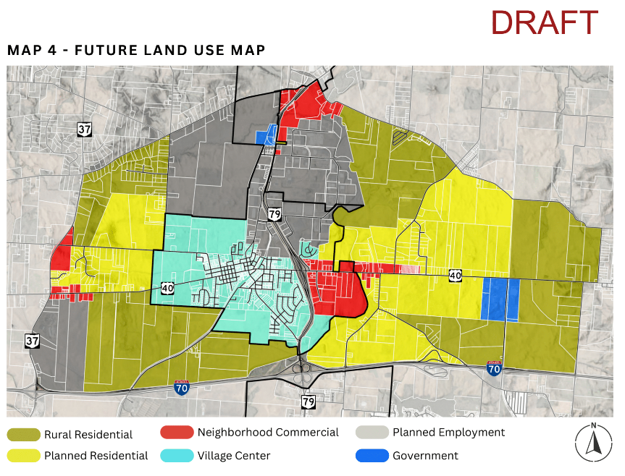
Existing development pressures
Hebron’s Future Land Use Plan
intel
Annexation
Expected to create over 20,000 direct and indirect jobs. Housing is needed in the region to support this growth.
By Heath and Hebron. Hebron’s plans show potential annexation up to Rt 37.
Tested
Conducted testing with young farmers in the area
Regional growth
proximity
While Intel is important, Central Ohio is seeing general growth.
Proximity to major routes makes Union Township attractive to developers.
Notes:
Not all about Intel: General growth of Central Ohio, Amazon, Honda, Google, Etc. is developing a Silicon Heartland right here. Central Ohio expected to have over 3 million residents by 2050.
Annexation: Township loses control over what types of development occur when a property is annexed. Hebron has draft plans for planned employment centers and neighborhood commercial in Union Township. Development is coming– what if the Township could control what it looked like instead of completely losing control?

Slide 7
WHAT HAPPENS IF WE DO NOTHING?

Slide 8
Canal Winchester along us 33
Notes:
An example of how developers can use leverage to force development on communities
Developer proposed warehouses on land adjacent to both Canal Winchester and Columbus. The area is near the Rickenbacker Freight Zone.
Approached Canal Winchester to annex and rezone. Canal Winchester agreed in order to keep the tax base in their community.
Residents filed a referendum on the rezoning.
The developer had required a clause into the annexation agreement that they could de-annex and merge with Columbus if the zoning was not approved.
Because these warehouses would be built regardless of the referendum outcome, Canal Winchester’s council voted to rezone again and declared an emergency to prevent another referendum.
While many residents were furious, Canal Winchester guaranteed over $200,000 per year to their school district, as well as $4.3 million in developer contributions-for a development the Council was powerless to stop.

Slide 9
Liberty township along sawmill parkway
Notes:
An example of how extensive litigation is costly and not always effective
In the early to mid-2000’s, both a Wal Mart and Target were proposed on separate sites in Liberty Township.
A complicated case. Liberty chose to fight both in court. They rejected the Wal-Mart and the developer sued. They lost in court and were required to pay $750,000 in compensation, and $1.2 million of the developer’s legal fees. They also paid over $1.5 million in their own fees.
Despite the developer’s victory, the delay caused Wal-Mart to move on from the site.
Target was proposed on a site that had been annexed into Powell. Liberty sued Powell stating that they had not properly administered their zoning.
After a 2 year court battle, the courts ruled that the Township did not have standing to challenge the zoning permit, since it was issued and administered by Powell.
Despite this, Target also lost interest in the site. HOWEVER…
In 2013, Target applied to build a store on the former Wal-Mart site. Residents once again wanted the Township to oppose the development. However, given their various legal losses and expenses incurred, the Township approved the development. Today the Target you see in this photo is operating in Liberty.
While Liberty Township did have some success in delaying development, they ultimately spent several million dollars to lose their cases and end up with a Target anyways.

Slide 10
Goals Overview
vision
Union Township is a community that desires to preserve its rural character, sense of community, and quality of life while balancing growth to diversify its tax base and enhance its services. Union Township will achieve this vision through fostering effective communication channels with residents as well as community and regional partners and being intentional with its development approach.
4 key themes
Key Theme #1 - Balancing Growth and Preservation to Protect and Enhance the Quality of Life
​
Key Theme #2 – Fostering Partnerships to Enhance Community Services
Key Theme #3– Supporting Sustainable Infrastructure
Key Theme #4– Promoting Economic Prosperity

Slide 11
Goals
The draft goals presented at the open house are displayed at the Township hall.
Please review these at the back of the room after the meeting.

Slide 12
Previously completed
Economic development strategy
Planning for the future
The Economic Development Strategy identified areas for TIFFs and JEDDS.
These require updated land uses.
The Economic Development Strategy is one of the main reasons for developing the Comprehensive Plan. We are focusing growth to these areas identified for economic development tools.
This includes an overlay district.

Slide 13
What is an overlay district?
Overlay district
Why pursue an overlay district?
A district layered on top of another zoning district. Provides use and development standards (road setbacks, aesthetics, architecture, landscaping, and other design elements, building dimension, density, etc.) to promote quality development.
Recent land uses, pressures around the highway interchanges, and threats of annexation are at the Township’s doorstep. Overlay districts allow the Township to create standards that align with the vision while allowing land uses and densities that support sewers which discourage annexation.
Notes:
While overlay districts allow development, the Township is able to retain control – uses, setbacks, landscaping, design standards and aesthetics- to make sure the development is of a high quality and aligns with the Townships goals. Without an overlay, if this same property were to be annexed, it would be developed without any Township control or design requirements, leaving you with a development that does not fit the Township’s vision.
Overlay Districts are often referred to as a “cloud”, because they apply to a specific area of the Township, identified by the subarea boundaries. The unique thing about this “cloud” is that the underlying zoning continues to apply to the land until such time a property owner chooses to pull down the “cloud” by submitting and receiving approval of a development plan that complies with the specific criteria in the Overlay District text. It gives flexibility to landowners by offering two options for developing the land – the underlying zoning or the overlay zoning. Once a property owner chooses to pull down the “cloud” then the underlying zoning is removed. Individual property owners may pull down the cloud at different times, but it is done within the overall zoning framework of the Overlay District. The overlay is not intended to benefit a single property owner but is designed to create overall, cohesive corridor development.

Slide 14
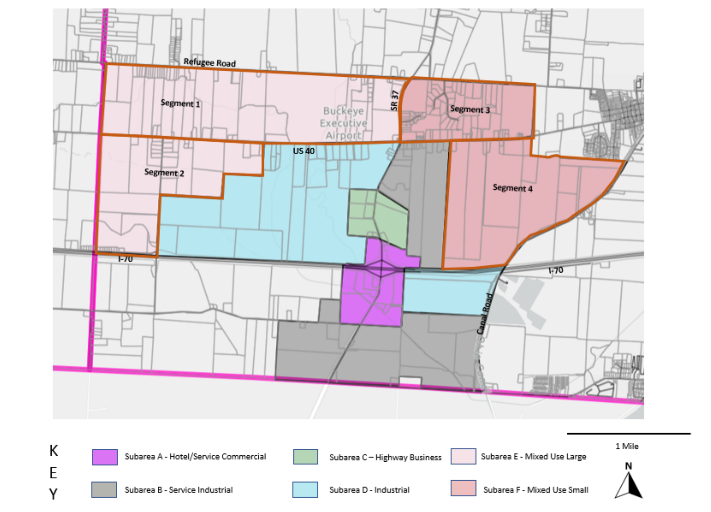
GATEWAY
CORRIDOR
OVERLAY
DISTRICT
overview
A unified development approach along 70, 37, and 40.
Competitors
Contains architectural, landscaping, parking, lighting, sign and other requirements to create a unique and high-quality design.
Notes:
Subarea A allows for hotel and service commercial uses aligning with its location along I-70.
Subarea B allows for parks and recreation facilities as well as some light commercial-industrial uses.
Subarea C generally allows commercial retail and office uses.
Subarea D allows for a variety of innovative, advanced manufacturing uses along with research and development facilities.
Subareas E and F allow for mixed use buildings within a walkable setting. Mixed Use buildings are defined as buildings with retail and office uses on the first floor and residential uses on the upper floors.

Slide 15
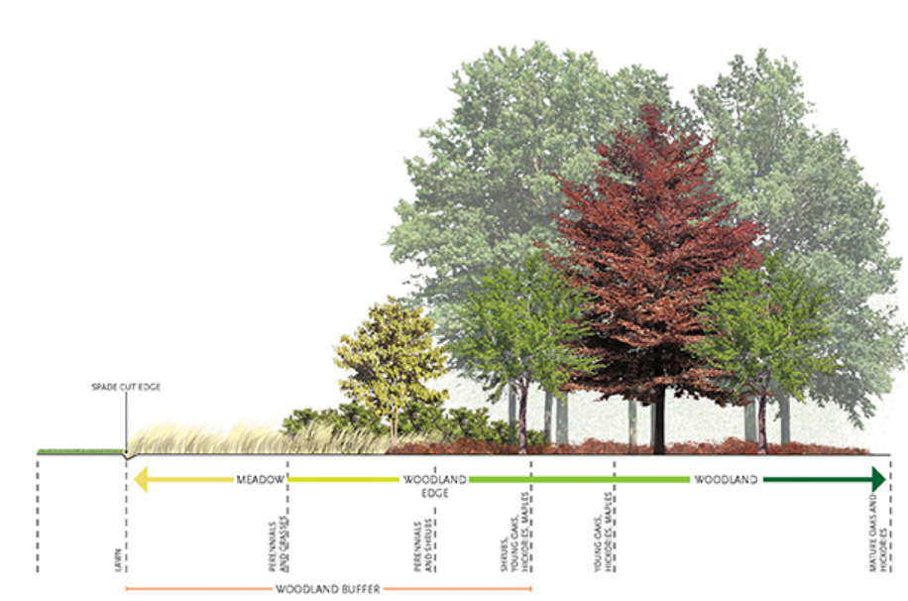
What standards are included to enhance the townships vision?
200-foot woodland buffer along Canal Road.
Minimum tract size of 25 acres to ensure a cohesive plan.
Promotion of the use of green infrastructure such as pervious pavement, rain gardens, green roofs.
Mixed use developments must have 30% of gross acreage as dedicated open space or land for schools.
Caps set on multi-family units in each Mixed-Use segment.
High quality building materials – no vinyl or cinderblock.
Trees must be planted along road frontage.
10-foot multiuse path required.
Notes:
Lighting plans, landscape plans, adherence to all stream and wetland standards by the Army Corps of Engineers, Ohio Environmental Protection Agency, and Licking County Planning Commission, and more.
GREEN INFRASTRUCTURE: Reduces impervious surfaces, which helps with runoff, rain gardens and even potentially green roofs help with keeping a naturalized look – this would not cost the Township or residents anything and would be put in by developers if completed

Slide 16
summary
The GCO overlay district allows inevitable development to occur in a targeted area due to external development pressures, but ensures it is completed under thorough high-quality standards that discourage annexation and retain Township control. Through this, the Township can guide development to this specific area, rather than throughout the whole Township.

Slide 17
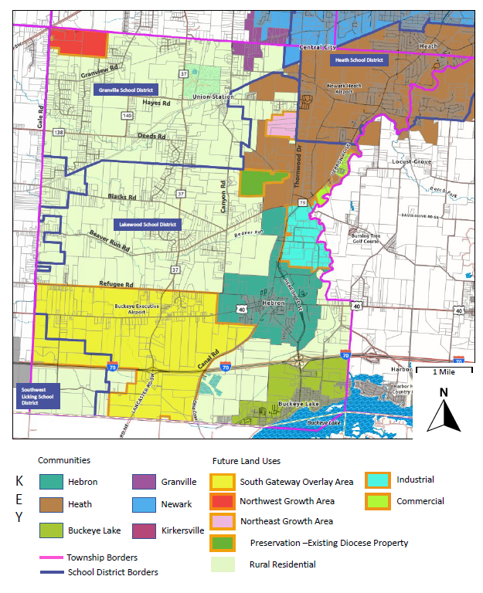
Union township future land use map
Notes:
This is not a zoning map- shows overview of proposed land use types, not specific zoning districts. Mostly rural residential with targeted growth areas. The yellow is the Gateway Corridor Overlay District.

Slide 18
What we’ve heard so far: Community survey
values
development
Respondents valued the rural character, open space, quiet, privacy, quality of life, high-quality schools, proximity to cities and major routes that Union Township offers.
When asked what residents wanted to see, 3 responses higher than any other regarding future development: Clustered Single Family, Mixed Use, and None of the Above.
Wanted Mixed Use in southern parts of Township, along 37/40, and near Hebron.
Recreation
services
Over 67% of respondents said they would use trails/multiuse paths in open spaces if they were available.
Consistent feedback regarding the desire to improve roads within the Township.
Notes:
Sent out June 2023
DEVELOPMENT: Note that people were able to pick more than 1: Options were Neighborhood Commercial, Mixed Use Buildings, Traditional Single-Family Homes, Clustered Single-Family Homes, Multifamily Ranch, Multifamily Flats, Large Industrial, Senior Housing, and Assisted Living. Mixed Use had over 35% of respondents, Clustered Single Family had over 34% and None of the above had almost 33%. There is a split in desires here – some residents wanted to stick to what the Township has traditionally looked like, others wanting to bring in new types of uses in strategic areas.

Slide 19
What we’ve heard so far: open House
General consensus
Points of discussion
Wide agreement on protecting ground water, improving roads, collaboration with regional partners as well as with fire, law enforcement, and school districts, and protecting farmland.
Concerns about loss of farmland, encroachment on property, a desire for the Township to be mindful regarding development, also some interest in collaborating with Heath and Hebron, and avoiding New Albany’s footsteps.
APPROVING | MIXED OPINIONS | DISAPPROVING
Keeping rural identity | Commercial Spaces | Warehouses
Improving quality of life features | Status Quo | Multi-Family Housing
Balanced Approach | Single-Family Housing

Slide 20
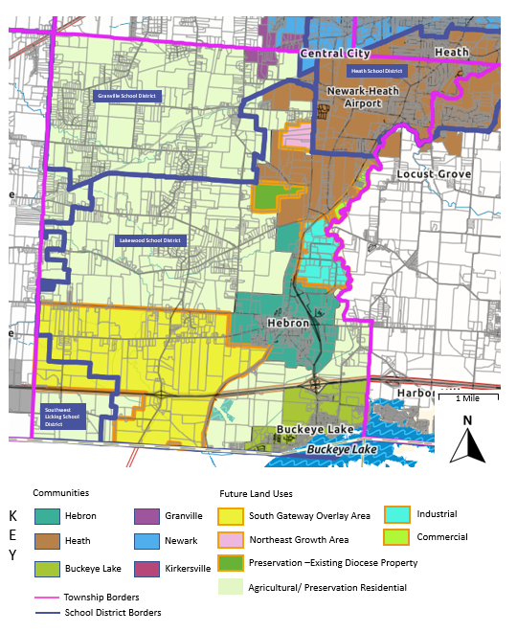
How we have responded
Removal of nw growth area
Maintain as agricultural/preservation residential.
Land use amendment
Change from “rural residential” to “agricultural/preservation residential”.
Notes:
The map shown at the open house contained a northwest growth area that would focus on industrial and commercial development. Due to feedback from the community, this has been removed from the plan. Additionally, from survey feedback, we will add a recommendation to pursue a preservation residential use designation, meaning 1.5 minimum acre lots with at least 50% open space.

Slide 21
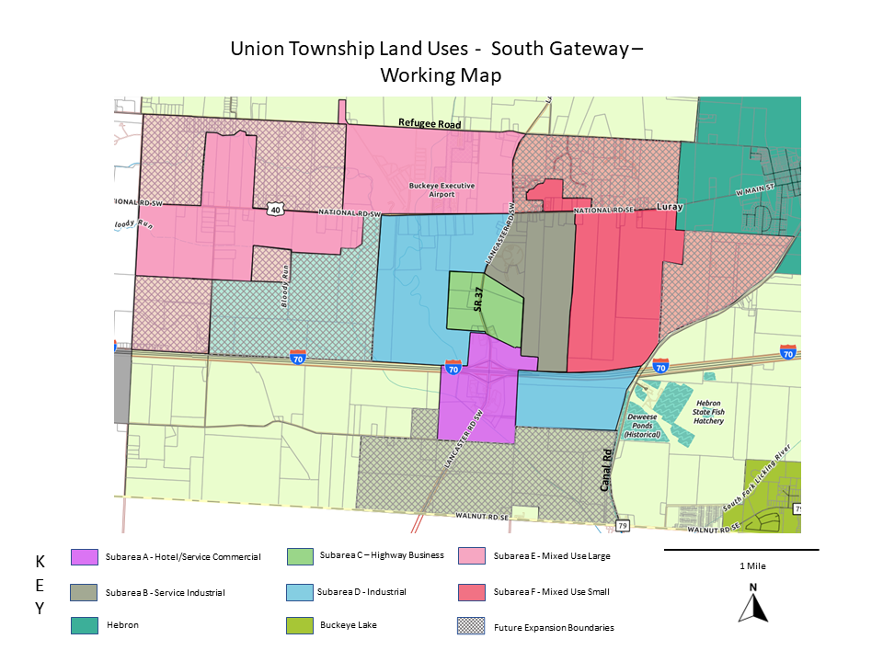
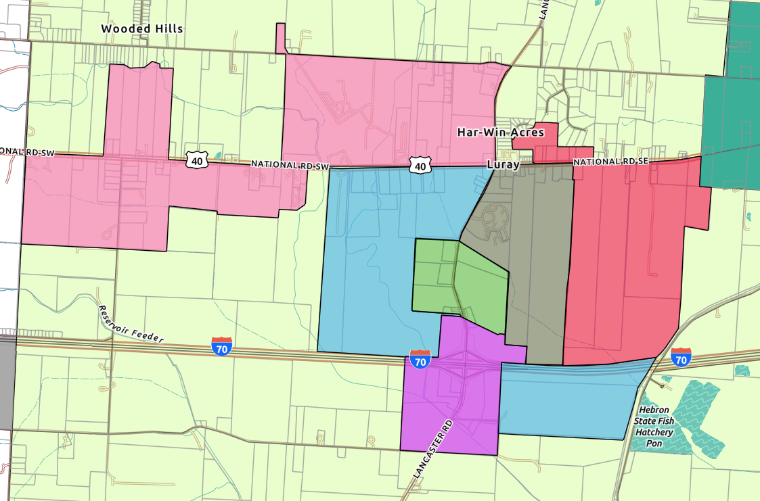
How we have responded
Reduction of overlay boundaries
From feedback, we have reduced the boundaries Subarea B, Subarea D, Subarea E, and Subarea F.
Refugee Rd
SR 37
Canal Rd
Area to be included in Overlay District at adoption.
Notes:
We will retain the original borders as a recommendation for these parcels to be added into the overlay as they join the JEDD. We formulated these updated boundaries to align more with the existing JEDD.

Slide 22
Next steps
Revise plans from feedback received at the open house and this meeting.
Develop detailed recommendations for the Comprehensive Plan.
Finalize a draft of the Gateway Corridor Overlay.
Hold a public engagement session to review revisions.
Begin process to adopt the Comprehensive Plan and Overlay District.
Questions?

